Slide 1
Collaborative Filtering
(Latent Factor Models)
Group C

Slide 2
Outline
Overview of Recommender System
Problem Formulation
Latent Factors Model
Demonstration
Summary

Slide 3
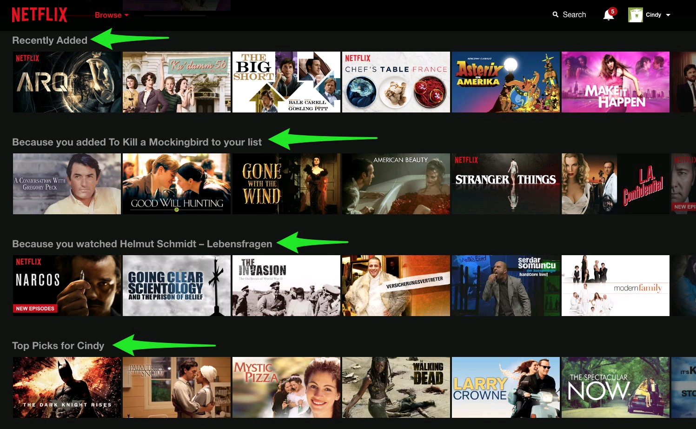
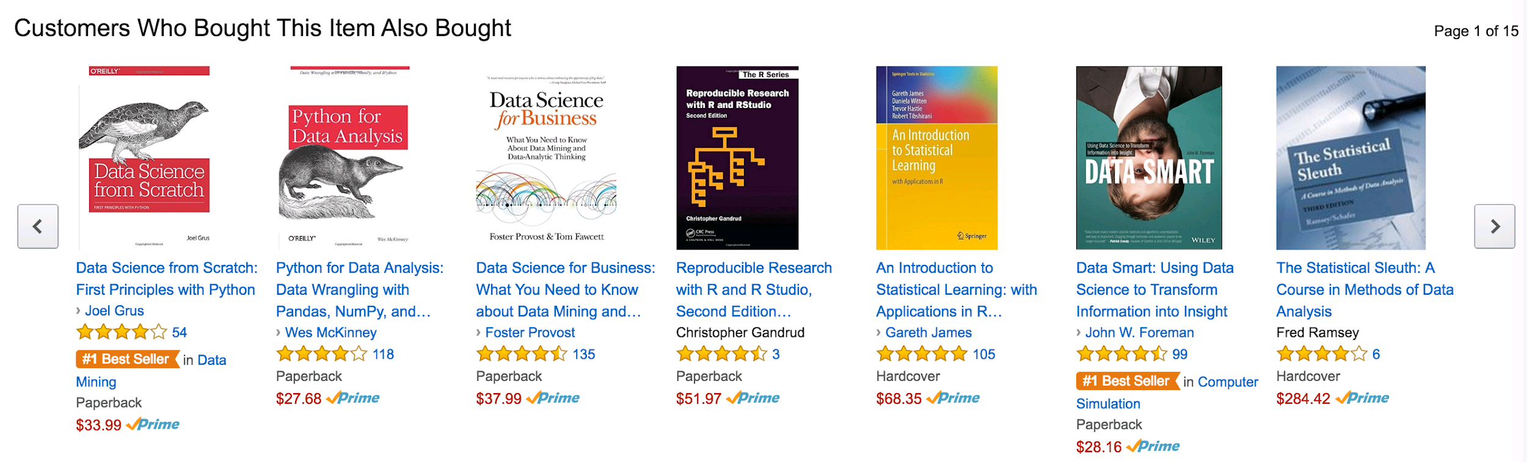
Recommender System
Predicting “preference” between user and item
Example: Online shop (Amazon, Taobao), Netflix, Facebook, Twitter

Slide 4
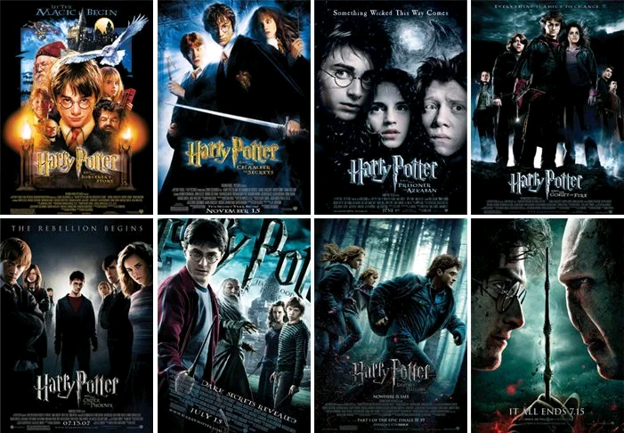

Approaches to Recommender System
Content-based Filtering
Based on feature of user or item
Collaborative Filtering
Based behaviour of user
Do NOT need to have feature of user or item

Slide 5
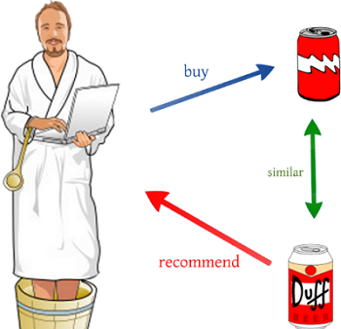
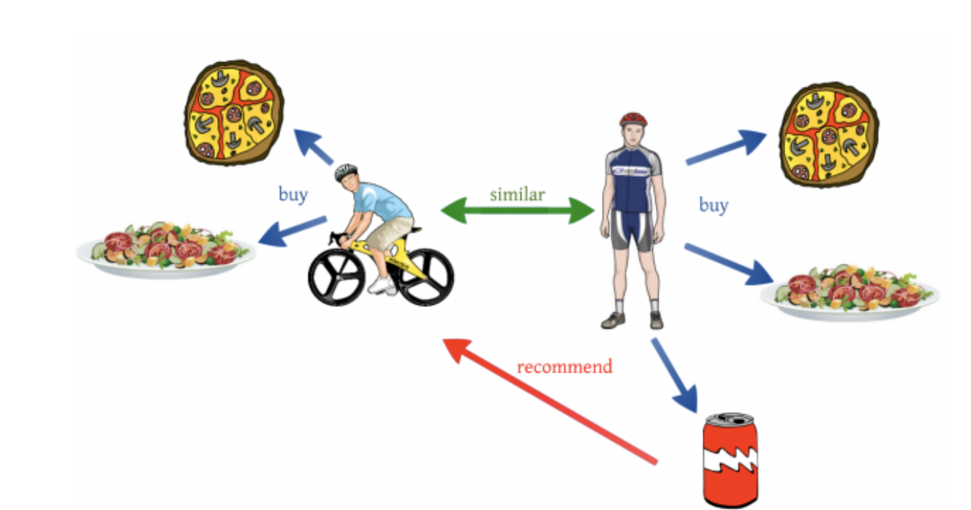
Collaborative Filtering (CF)
Memory-Based
Item-based: similarity among item
User-based: similarity among user
Model-Based
Latent Factor Models (Matrix Factorization)
Clustering Models
Bayesian Network
Principal Component Analysis (PCA)
Hybrid
Combination of memory-based and model-based
Notes:
The two pictures in this slide show the difference between content-based filtering and collaborative filtering. The difference between Memory-based and Model-based in the last slide.

Slide 6
Problem Formulation
For illustration, we will use movie recommendation system as an example.
Assume there are only m customers and n movies:
Question? How to fill the missing data and make recommendation to the user using latent factor model?
 | Movie A | Movie B | Movie C | …... | Movie n
Customer 1 | 5 | 5 | 1 | …... | 4
Customer 2 | 5 | ? | ? | …... | 3
Customer 3 | ? | 2 | 5 | …... | ?
…... | …... | …... | …... | …... | 1
Customer m | 1 | ? | 2 | …... | ?

Slide 7
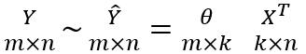
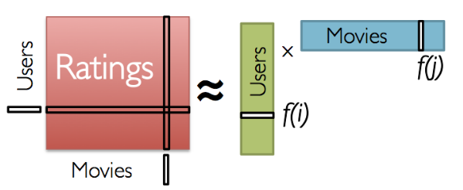
Latent Factor Model (Matrix Factorization)
Model each user/item as a vector of latent (hidden) factors (k)
m: number of users
n: number of movies
k: number of latent factors, where k << m, n
The rating matrix Y can be approximate as:

Slide 8
Latent Factor Model (Matrix Factorization)
Number of users | m
Number of movies | n
True rating matrix | Y (m x n)
Predicted rating matrix | Y_hat (m x n)
Number of latent factors | k
User factor matrix | Theta (m x k)
Movie factor matrix | X (n x k)

Slide 9
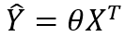
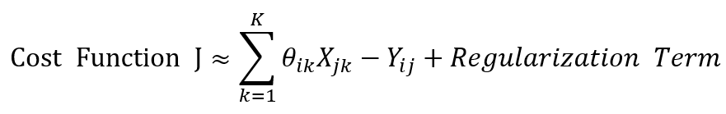
Latent Factor Model (Matrix Factorization)
Step 1: Randomly initialize the parameters Theta and X
Step 2: Calculate the prediction Y_hat by compute the dot product of Theta and the transpose of X
Step 3: Define a cost function based on the difference between Y and Y_hat
Step 4: Minimize the cost function using gradient descent
Step 5: Make recommendation to the users using the prediction matrix Y_hat

Slide 10
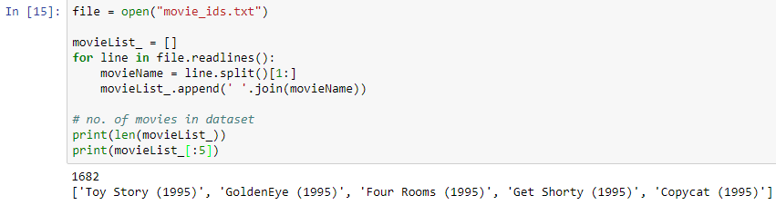
Demonstration: Loading Data (1)

Slide 11
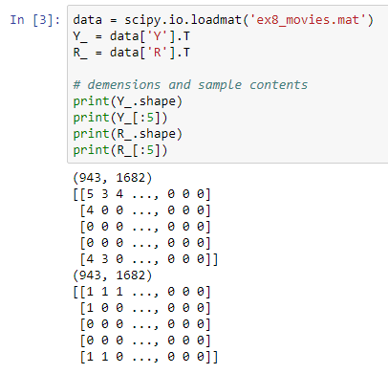
Demonstration: Loading Data (2)
Y = R(943x1682) {0, 1, 2, 3, 4, 5}
Users Preference on the Movies
R = R(943x1682) {0, 1}
Whether Users rated the Movies

Slide 12
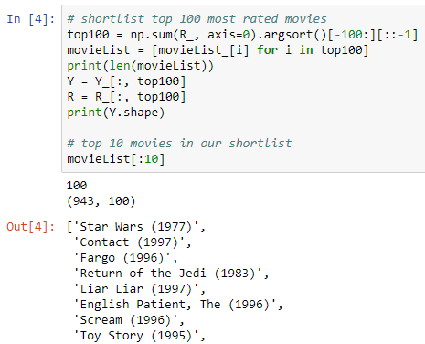
Demonstration: Data Pre-processing (1)
Shortlist the top 100 movies with the most rating activities
Movies are from 60’s to 90’s

Slide 13
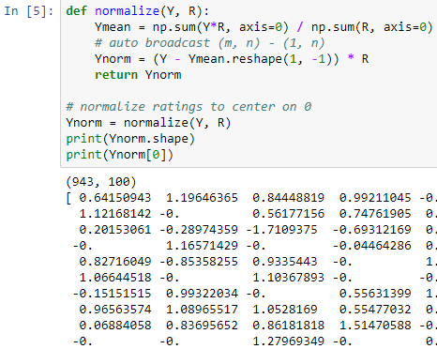
Demonstration: Data Pre-processing (2)
We want an average score for movies that have not been seen or rated by users.
Ymean is the mean for each movies

Slide 14
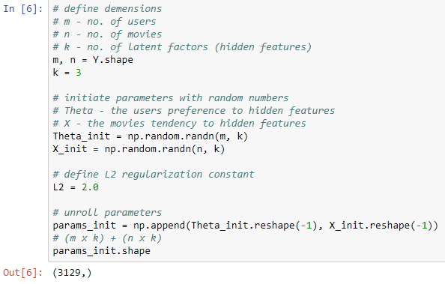
Demonstration: Parameters Initiation
We don’t have to know in advance what the 3 latent factors are.
Theta.dot(X.T) = Y_hat

Slide 15
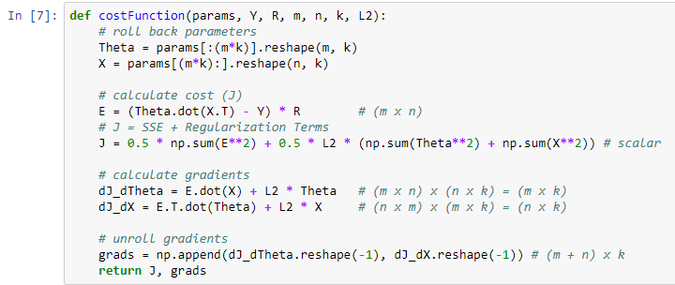
Demonstration: The Cost Function

Slide 16
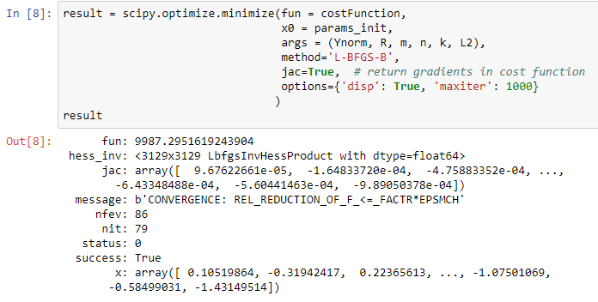
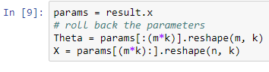
Demonstration: SciPy Optimizer

Slide 17
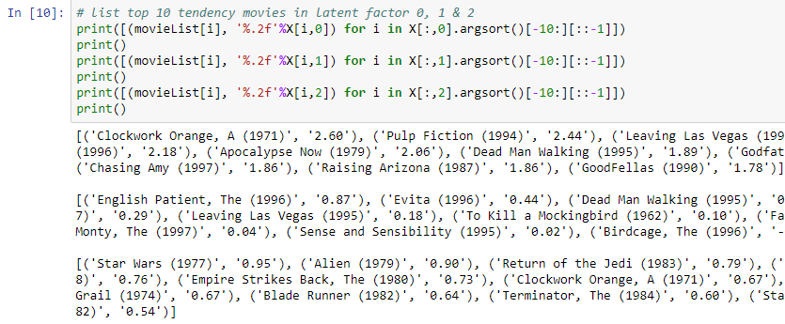
Demonstration: Latent Factors Analysis

Slide 18



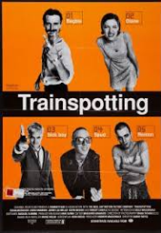
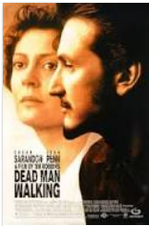

Demonstration: Latent Factors (1)
Which Types have High Score?
Criminals
Violence
Drugs Taking

Slide 19



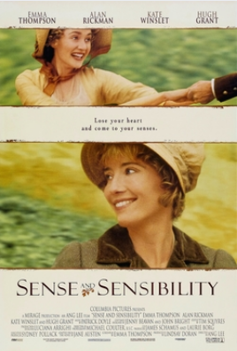
Demonstration: Latent Factors (2)
Which Types have High Score?
Feminanine
Romance
Musical

Slide 20
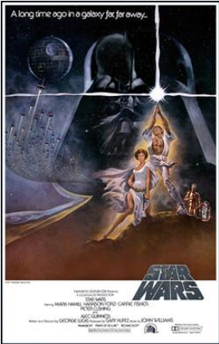





Demonstration: Latent Factors (3)
Which Types have High Score?
Commercial
Sci-fi
Action

Slide 21
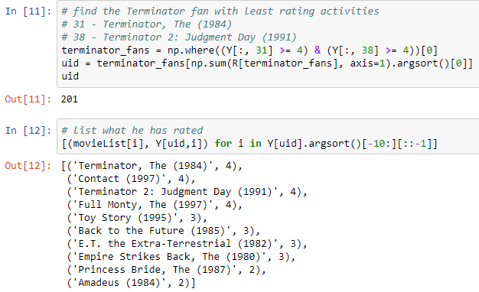

Demonstration: Movies Recommendation

Slide 22
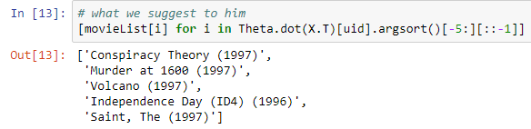
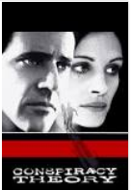



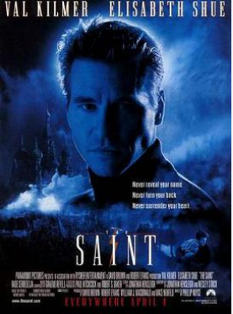
Demonstration: Movies Recommendation

Slide 23
Summary
In this presentation, these should be your takeaways:
Have an idea in the big picture of collaborative filtering.
The concepts of latent factors method in collaborative filtering.
Acknowledged how to apply collaborative filtering to recommend movies.

Slide 24


Links to the External Resources
Youtube
https://youtu.be/w2QQPuzeqmI
GitHub
https://github.com/kenchan0824/hku-comp7404-project

Slide 25
Reference (1)
https://arxiv.org/ftp/arxiv/papers/1503/1503.07475.pdf
http://www.bigdatafinance.tw/index.php/379-2017-05-10-08-05-49
http://dsec.pku.edu.cn/~jinlong/publication/wjlthesisppt.pdf
http://augus-blog.logdown.com/posts/143404-mahout-tutor-1
https://www.quora.com/What-is-the-difference-between-content-based-filtering-and-collaborative-filtering
http://www.ideal.ece.utexas.edu/seminar/LatentFactorModels.pdf

Slide 26
Reference (2)
https://www.coursera.org/learn/machine-learning
https://hackernoon.com/introduction-to-recommender-system-part-1-collaborative-filtering-singular-value-decomposition-44c9659c5e75

Slide 27
Q&A

Slide 28
Content-based Filtering Example
Assume items that are interested to the user having similar features/characteristics to those items that have scored high by the user in the past
Calculate the similarity between different items
Recommend the item (item Y) having highest similarity to the previous scored high item to the customer
 | Feature 1 | Feature 2 | Feature 3 | Score
Item W | 4 | 2 | 2 | 10
Item X | 2 | 2 | 4 | 2
Item Y | 4 | 2 | 1 | unknown
Item Z | 2 | 2 | 3 | unknown

Slide 29
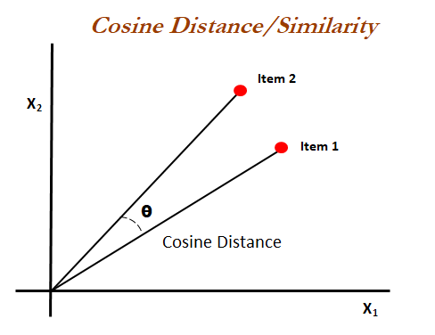
Similarity
Example: calculate the cosine value of the angle between two vectors
Cosine value = 0 ⇒ angle between two vectors = 0 ⇒ same scoring pattern
Cosine value = 1 ⇒ angle between two vectors = 180 degree ⇒ different scoring pattern
Other ways to calculate the similarity
Pearson correlation coefficient
K-nearest neighbor (KNN)
Restricted Boltzmann machine (RBM)
Matrix factorization model
Fuzzy K-means

Slide 30
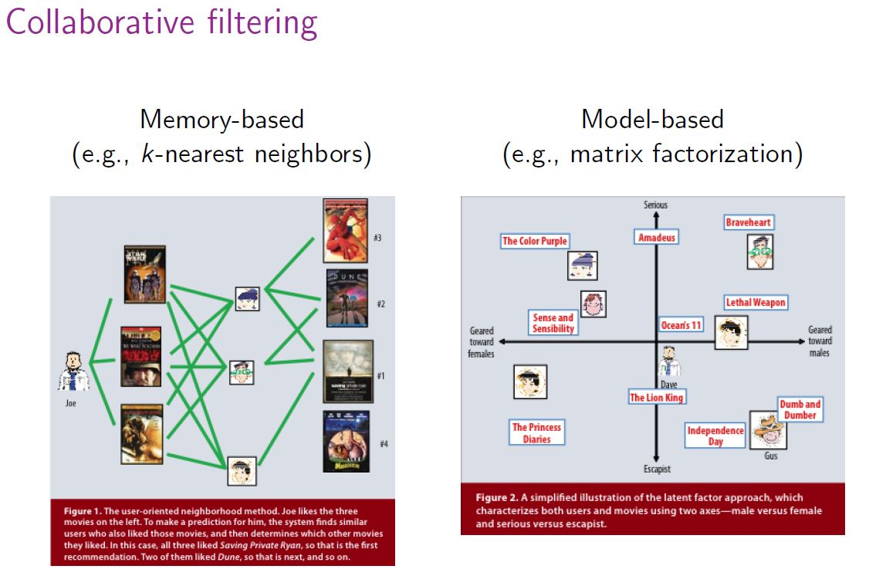
Memory-based vs Model-based

Slide 31
Collaborative Filtering (CF)
Advantages
Making use of other users’ experience can speed up the learning process.
Recommend items based on other users’ preference. Potential interest can be discovered.
Complicated concept like personal taste can be explored.

Slide 32
Collaborative Filtering (CF)
Drawback
Cold start (new user and new item)
Sparsity
The required calculation time increase as the number of users in the system increase
Low bias but high variance compare to content-based filter ⇒ suspicious to overfitting

